Slide 1
Software Engineering
Perspective Process Model
Evolutionary Process Model
Test Driven Development Process

Slide 2
What is Perspective Model?
Prescribed set of process elements and a predictable process work flow
“prescriptive” because they prescribe a set of process elements framework activities, software engineering actions, tasks, work products, quality assurance, and change control mechanisms for each project
Types –
Waterfall Model
Incremental Process Model
RAD Model

Slide 3
What is Evolutionary Model?
Iterative in nature that enables software engineers to develop increasingly more complete versions of the software
Types -
Prototyping Model
Spiral Model

Slide 4
Waterfall Model
Also known as Linear Sequential Model because it suggests workflow from Communication through Deployment in linear fashion
Also known as Classic Life Cycle Model because it suggests a systematic sequential approach to software development
Suitable for small projects
feedback is taken after each phase to ensure that the project is on the right path

Slide 5
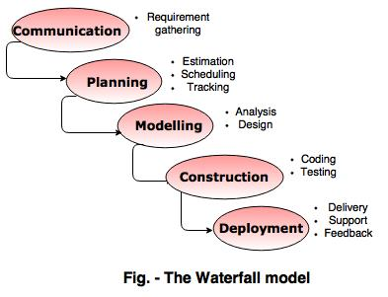

Slide 6
Communication =
requirements are gathered from the customer and recorded
Planning =
Cost and Time constraints are estimated, a schedule is outlined and project tracking variables are defined
Modelling =
Based on project requirements and constraints design the project ideas
Construction =
Generation of code and actual building of the product
Deployment =
Product is delivered, customer feedback is received support and maintenance for the product are provided

Slide 7
Advantage of Waterfall Model =
Simple to use and implement
Easily understandable workflow
Easy to manage since all the requirements are known at the beginning of the project
Can be applied to projects where quality is preferred over cost
Avoids overlapping of phases
Disadvantage of Waterfall Model =
Not good for complex and object oriented projects
Problems with this model are uncovered, until the software testing
High risk

Slide 8
Incremental Process Model
Combines the elements of waterfall model and they are applied in an iterative fashion
Series of releases (increment) are built and delivered to the customer
Each increment builds the product and submits it to the customer for any suggested modifications
Next increment implements on the customer's suggestions and add additional requirements in the previous increment
This process is repeated until the product is finished

Slide 9
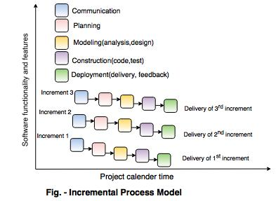

Slide 10
For example,
Word-processing software developed using the incremental paradigm might deliver basic file management, editing, and document production functions in the first increment; more sophisticated editing and document production capabilities in the second increment; spelling and grammar checking in the third increment; and advanced page layout capability in the fourth increment.

Slide 11
Advantages of Incremental Model =
Flexible to change requirements
Changes can be done throughout the development stages
Working software is available at early stage of the process
Easy to test because of small iterations
Disadvantage of Incremental Model =
The cost of the final product may cross the cost estimated initially.
Refining requirements in each iteration may affect system architecture
Breaking the problem into increments needs skillful management supervising
Requires good planning and design.

Slide 12
RAD Model
Rapid Application Development Model
Software product can be developed in short period of time
There are following Phases –
Business Modelling
Data Modelling
Process Modelling
Application Generation
Testing and Turnover

Slide 13
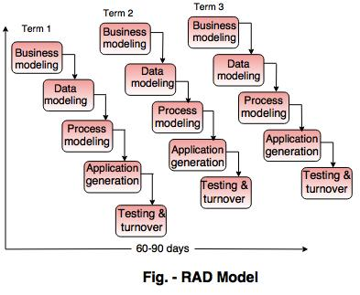

Slide 14
Business Modelling =
Complete business analysis should be performed to get the essential business information
Gather information through many business related sources
How data can be used, when it is processed and what is making this specific information successful for the industry
Data Modelling =
Information is refined into the set of objects
Attribute of each objects are identified and defined the relationship between two objects
Process Modelling =
Data objects defined in the data modeling phase are changed to fulfil the information flow to implement the business model
The process description is created for adding, modifying, deleting or retrieving a data object

Slide 15
Application Generation =
The actual system is built
To construct the software automated tools are used
Testing and Turnover =
Every module tested separately
Information is refined into the set of objects
Attribute of each objects are identified and defined the relationship between two objects

Slide 16
Advantages of RAD Model =
Flexible for change
Changes are adoptable
Reduced development time
Disadvantages of RAD Model =
Required highly skilled designers
All applications are not compatible with RAD

Slide 17
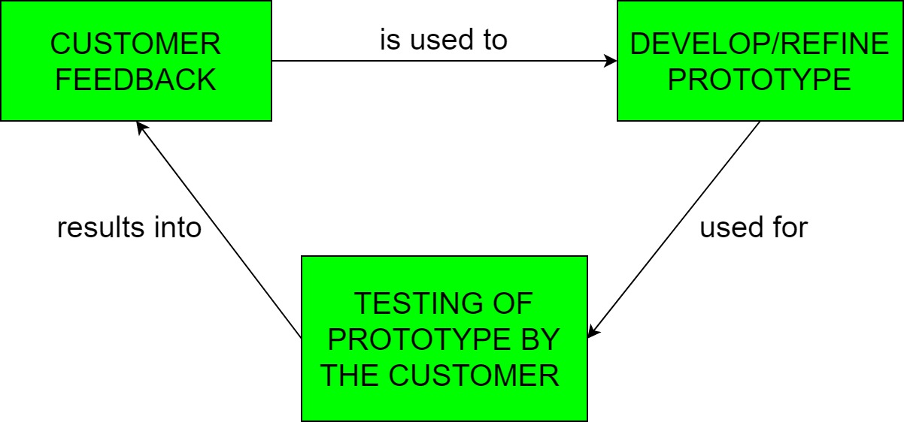
Prototyping Model
Prototyping – Process of developing a working replication of a product

Slide 18
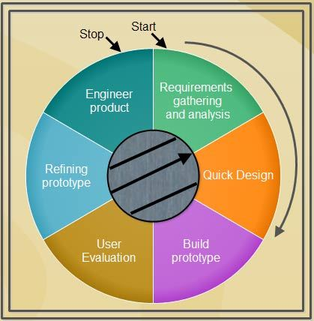
This model is used when the customers do not know the exact project requirements beforehand
Prototype of the end product is first developed, tested and refined as per customer feedback repeatedly till a final acceptable prototype is achieved
Steps-
Requirement gathering and Analysis
Quick Decision
Build a prototype
User evaluation
Prototype Refinement
Engineer Product

Slide 19
Advantages of Prototyping Model =
Customers get to see the partial product early in the life cycle
New requirements can be easily accommodated
Missing functionalities can be easily figure out
Errors can detected much earlier
Flexibility in design
Disadvantages of Prototyping Model =
Costly with respect to time and money
Poor documentation due to continuous change in customer requirements
Uncertainty in determining the number of iterations that would be required

Slide 20
Spiral Model
Proposed by Barry Boehm
Provides potential for rapid development of increasingly more complete versions of the software
Provides support for Risk Handling
Software is developed in series of evolutionary releases
Early iteration release might be prototype but later iterations provides more complete version of software

Slide 21
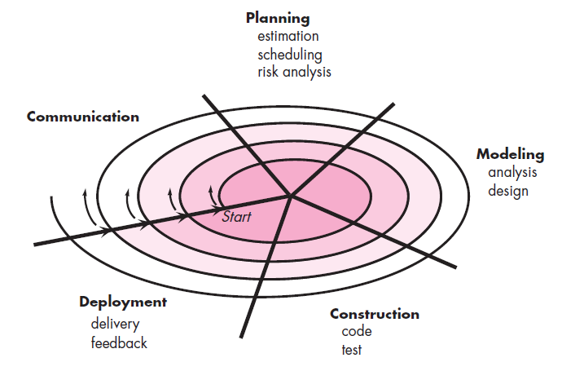

Slide 22
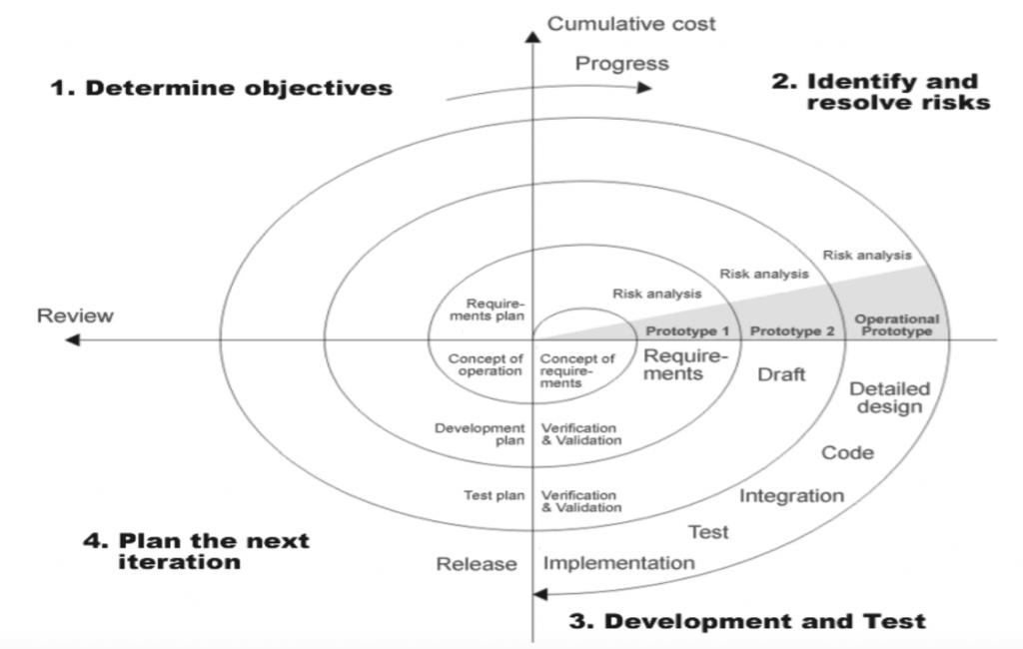

Slide 23
When to use Spiral Model =
For development of large scale / high-risk projects
When costs and risk evaluation is important
Users are unsure of their needs
Requirements are complex
Significant (considerable) changes are expected
Advantages of Spiral Model =
High amount of risk analysis hence, avoidance of Risk is enhanced.
Strong approval and documentation control.
Additional functionality can be added at a later date.
Software is produced early in the Software Life Cycle.

Slide 24
Disadvantages of Spiral Model =
Can be a costly model to use
Risk analysis requires highly specific expertise
Project’s success is highly dependent on the risk analysis phase
Doesn’t work well for smaller projects

Slide 25
Weakness of Evolutionary Model
Poses a problem to project planning because of the uncertain number of iterations required to construct the product
Evolutionary software processes do not establish the maximum speed of the evolution
If too fast, the process will fall into chaos
If too slow, productivity could be affected
Software processes should focus first on flexibility and extensibility, and second on high quality
We should prioritize the speed of the development over zero defects
Extending the development in order to reach higher quality could result in late delivery

Slide 26
Test Driven Development Process
Test cases are developed to specify and validates what the code will do
Test cases for each functionality are created and tested first and if the test fails new code is written and making code simple and bug-free
Test-Driven Development starts with designing and developing tests for every small functionality of an application
Instruct developer to write new code only if an automated test has failed

Slide 27
Sequence of Steps to follow –
Add a test – Write a test case that describe the function completely. In order to make the test cases the developer must understand the features and requirements using user stories and use cases.
Run all the test cases and make sure that the new test case fails.
Write the code that passes the test case
Run the test cases
Refactor code – This is done to remove duplication of code.
Repeat the above mentioned steps again and again

Slide 28
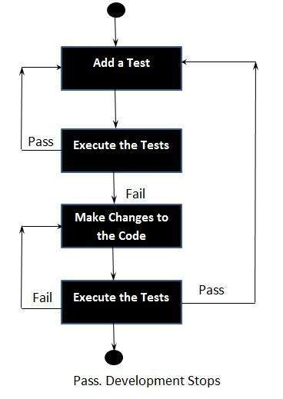

Slide 29
Context of Testing:
Valid inputs
Invalid inputs
Errors, exceptions, and events
Boundary conditions
Everything that might break

